Slide 1
RESTful API and SPA Functionalities Presentation
Lab 2 to Lab 6

Slide 2
Introduction
This PHP application utilizes the Slim Framework to create a RESTful API and Single Page Application (SPA). With a clear structure, it manages routes for user authentication, book and author data, and various functionalities. The use of Twig for templates and dependency injection enhances modularity. Controllers such as BookController, AuthController, UserController, and AuthorController handle specific actions. The application includes features like user sign-up, login, resource retrieval, creation, updating, and deletion, all secured with custom and bearer authentication. It demonstrates a streamlined approach to building web services and SPAs, ensuring efficient handling of data and user interactions.

Slide 3
Web Service Objective
The purpose of this Library Management System web service is to provide a robust and efficient platform for managing library resources and user interactions. It facilitates seamless access to a comprehensive set of functionalities, including user authentication, book and author information retrieval, creation, updating, and deletion. The web service aims to streamline the management of library assets, offering a secure and organized system for both administrators and users. By leveraging the Slim Framework, Twig templates, and various controllers, the application ensures a responsive and user-friendly experience. Overall, the web service serves as a centralized and scalable solution for effectively managing library-related data and operations.

Slide 4
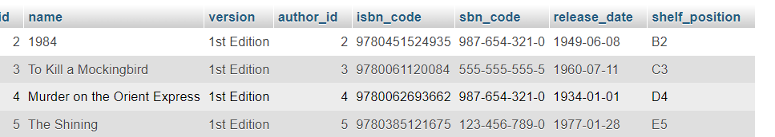
Database Structure
The Database consists of 3 tables, Authors, Books and Users tables.
Books table has author_id column which uses keys from authors table to connect the books with the authors
Author Table has author names and their date of births

Slide 5
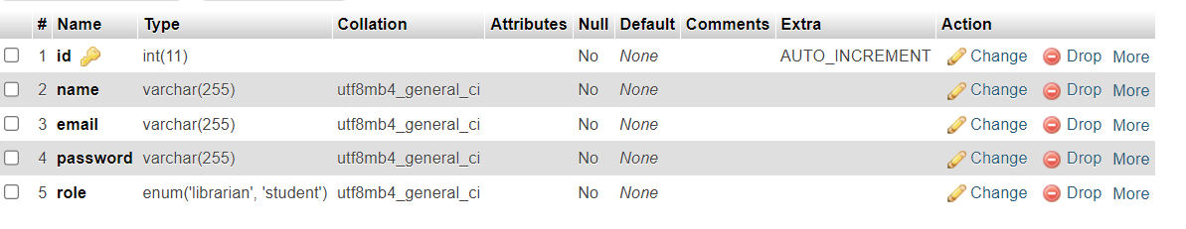
User table is the most essential as jwt authentication and login works by authentication data from users table
User table has the users which are registered in the application and their roles are assigned while signing in.

Slide 6
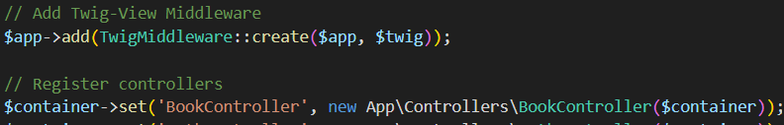
Web Service Route Patterns
Slim Framework Routing:
The Slim Framework provides a straightforward way to define routes.
Routes are specified using the $app instance and are associated with specific controller methods.
Examples given.

Slide 7
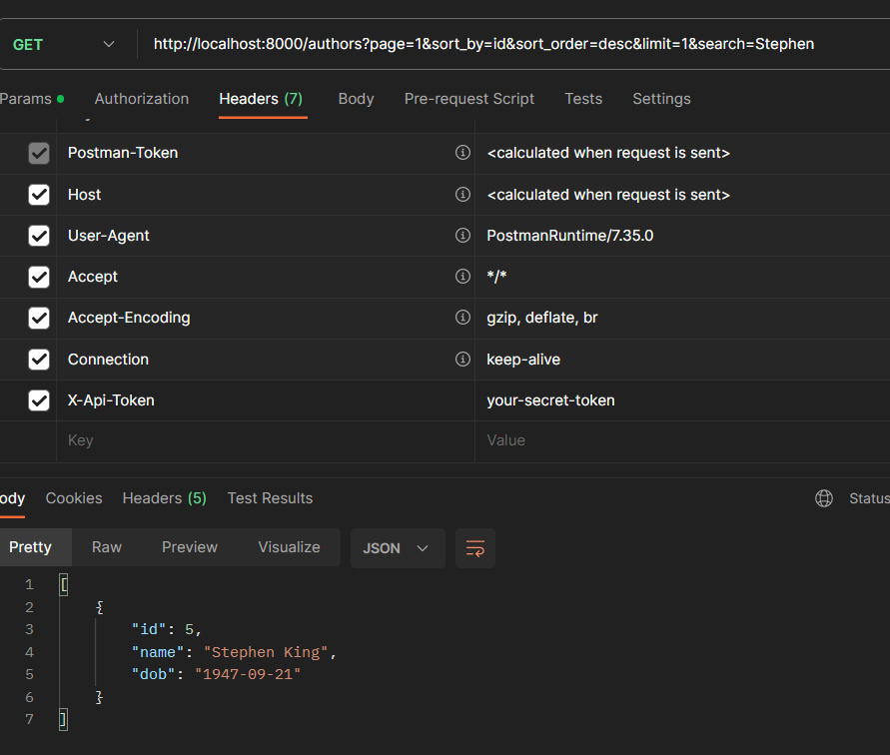
GET, POST, PUT/PATCH, and DELETE endpoints
Here is an example of GET request with all the search and sort features for fetching all authors data.
http://localhost:8000/authors?page=1&sort_by=id&sort_order=desc&limit=1&search=Stephen
X-Api-Token is used for authentication

Slide 8
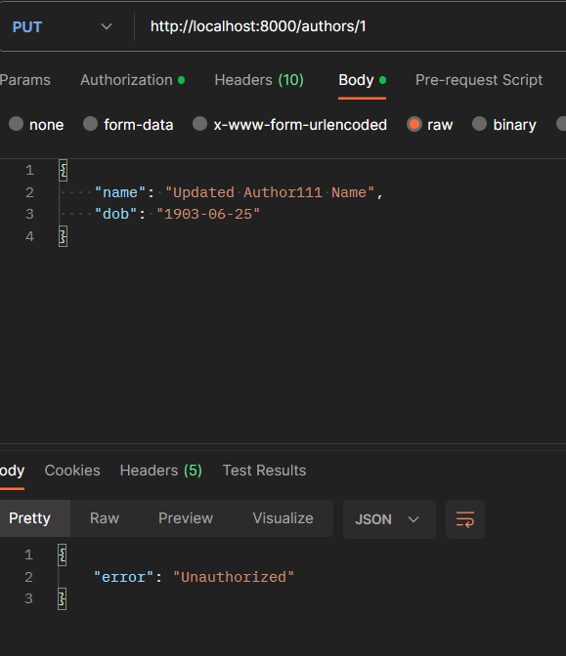
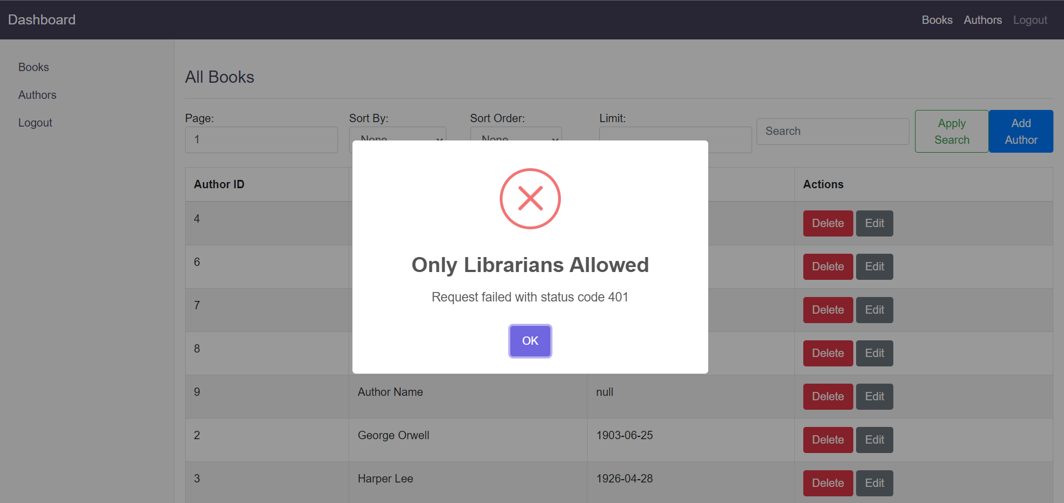
These Images are example for when we try to update data using bearer token for a student, so it doesn’t allow a student to update changes using put method

Slide 9
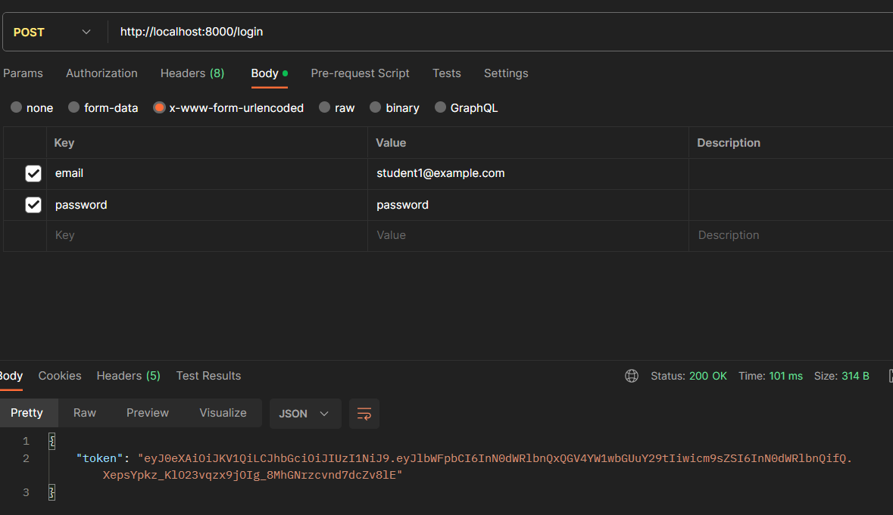
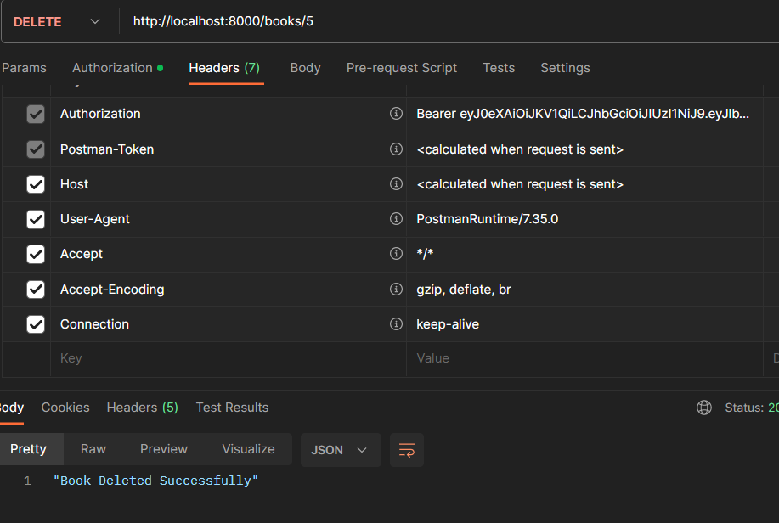
This is an example of POST request for Login of users where we login as a student and a jwt token is received for further authentication.
http://localhost:8000/login
This is an example of DELETE method in our application deleting a book using jwt authentication
http://localhost:8000/books/{id}

Slide 10
Thank You!

